Slide 1
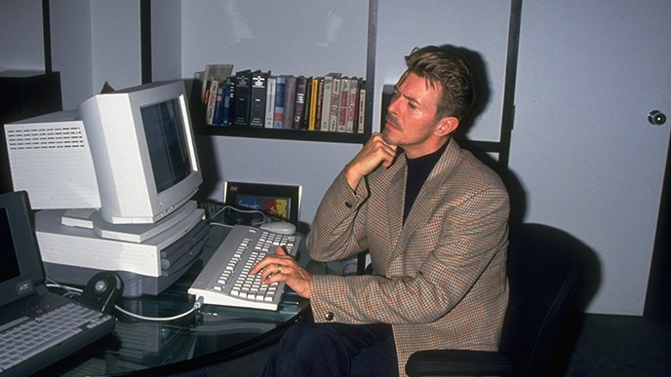
Types of scientific studies
Dr John Dwyer CONS7008

Slide 2
The scientific method
Research Question
Develop hypothesis(es) and predictions
Design and execute study to evaluate support for hypothesis(es)
Draw conclusions based on evidence

Slide 3
Strength of inference
Ability to draw conclusions about our POPULATION of interest from a SAMPLE
Ability to explain observed pattern and rule out alternatives
requires controls, randomisation, replication

Slide 4
Four main approaches
Conceptual models
Observational studies
Descriptive
Quantitative (using empirical models)
Mathematical models
Experiments

Slide 5
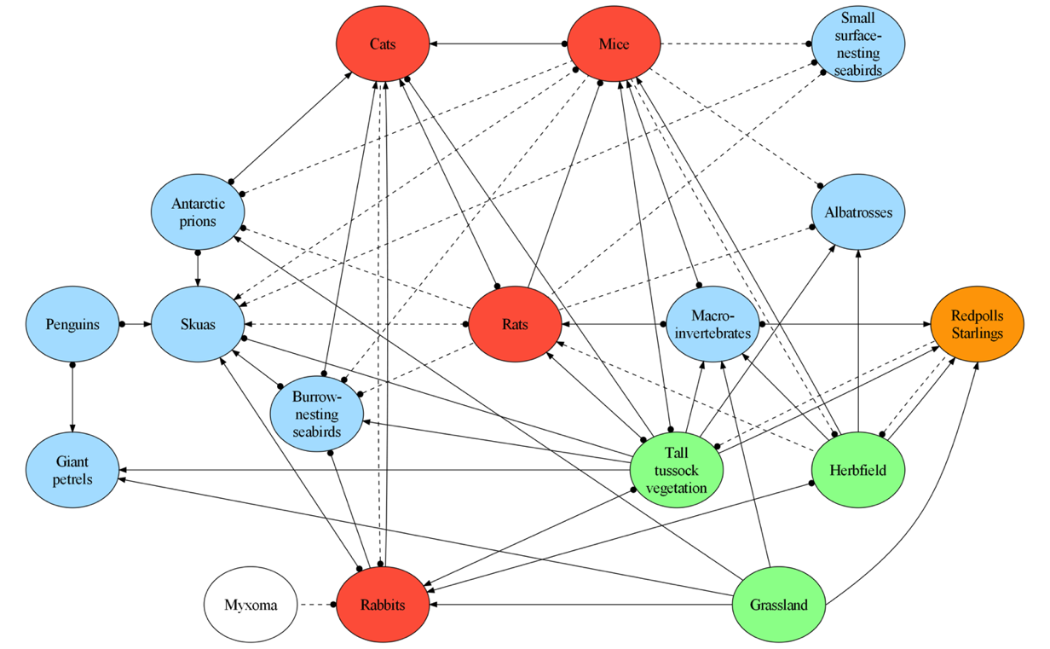
1. Conceptual models
A model is just a simplified representation of a system
Raymond et al 2011. J. Applied Ecology

Slide 6
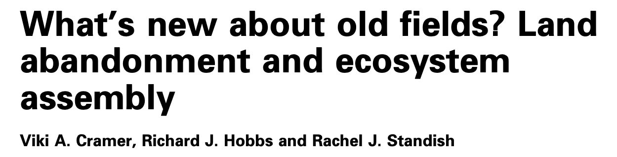
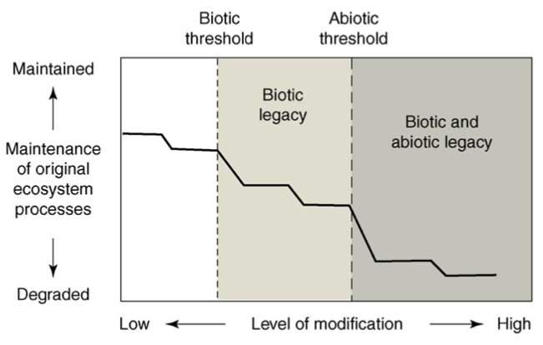

Slide 7
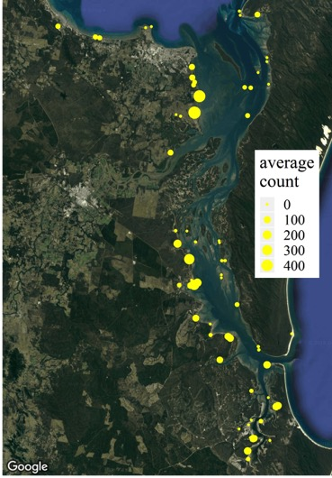
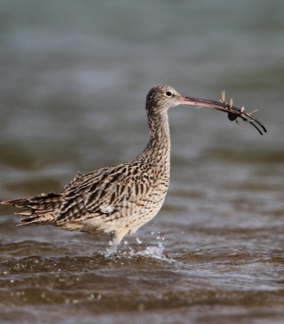
2a. Descriptive observational studies
Describe OBSERVED patterns using data
E.g. measure and visualise population trends through time or across space

Slide 8

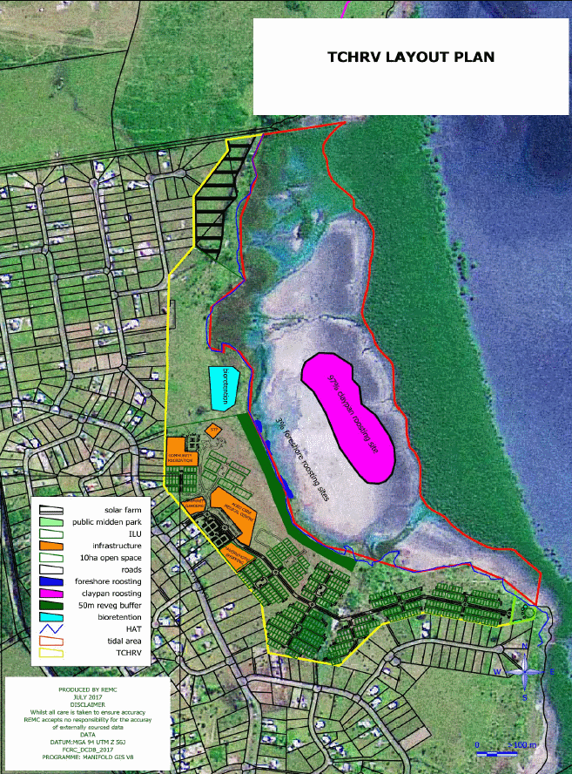
2a. Descriptive observational studies

Slide 9
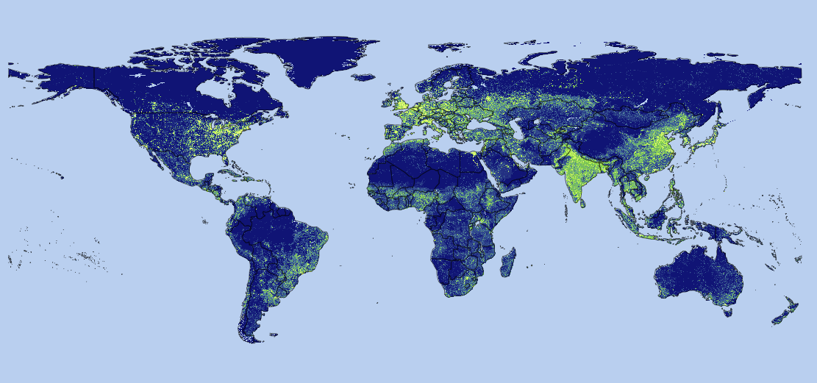
2a. Descriptive observational studies
Human Footprint, 2018 Release (2009)
Venter, O., E. W. Sanderson, A. Magrach, J. R. Allan, J. Beher, K. R. Jones, H. P. Possingham, W. F. Laurance, P. Wood, B. M. Fekete, M. A. Levy, and J. E. Watson. 2018. Last of the Wild Project, Version 3 (LWP-3): 2009 Human Footprint, 2018 Release. NASA Socioeconomic Data and Applications Center (SEDAC), Palisades, New York.

Slide 10
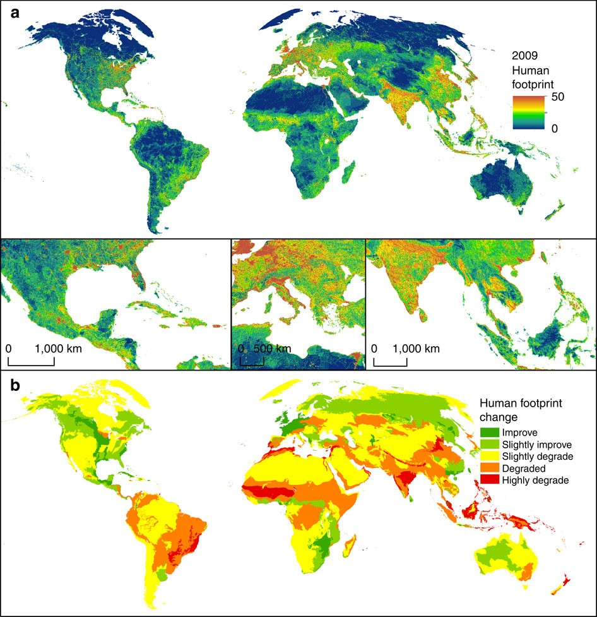
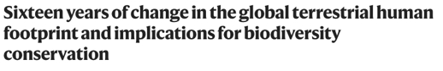
Venter, O., E. W. Sanderson, A. Magrach, J. R. Allan, J. Beher, K. R. Jones, H. P. Possingham, W. F. Laurance, P. Wood, B. M. Fekete, M. A. Levy, and J. E. Watson. 2016. Sixteen Years of Change in the Global Terrestrial Human Footprint and Implications for Biodiversity Conservation. Nature Communications:12558.
This is just a global example of “Measure and visualise trends through time and across space”!

Slide 11

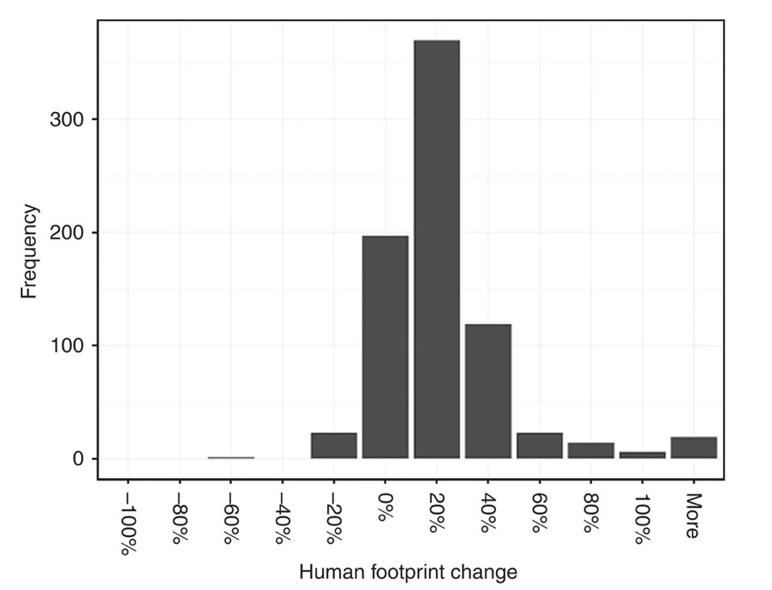
Venter, O., E. W. Sanderson, A. Magrach, J. R. Allan, J. Beher, K. R. Jones, H. P. Possingham, W. F. Laurance, P. Wood, B. M. Fekete, M. A. Levy, and J. E. Watson. 2016. Sixteen Years of Change in the Global Terrestrial Human Footprint and Implications for Biodiversity Conservation. Nature Communications:12558.
This is just a histogram – it is purely descriptive

Slide 12
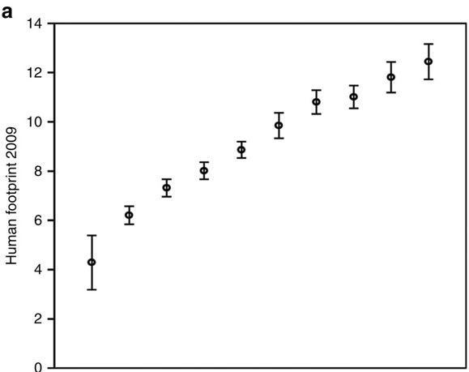
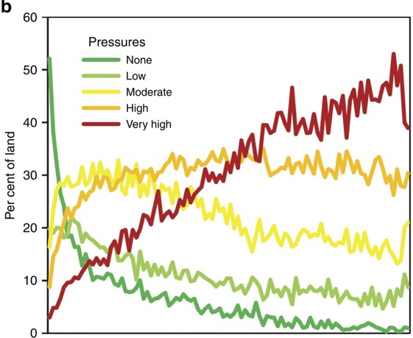


Venter, O., E. W. Sanderson, A. Magrach, J. R. Allan, J. Beher, K. R. Jones, H. P. Possingham, W. F. Laurance, P. Wood, B. M. Fekete, M. A. Levy, and J. E. Watson. 2016. Sixteen Years of Change in the Global Terrestrial Human Footprint and Implications for Biodiversity Conservation. Nature Communications:12558.
Even these are still mostly descriptive

Slide 13
2b. Quantitative observational studies
Test support for a model with data
Can be explanatory or predictive
Are we explaining the trends in the data we collected?
Or predicting outcomes for places we didn’t sample
Almost always CORRELATIVE

Slide 14
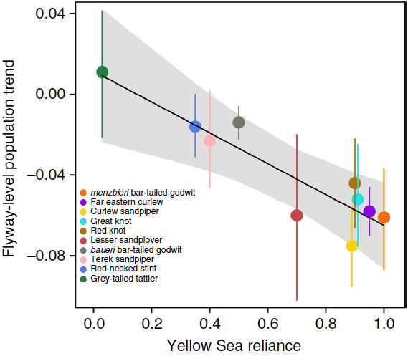
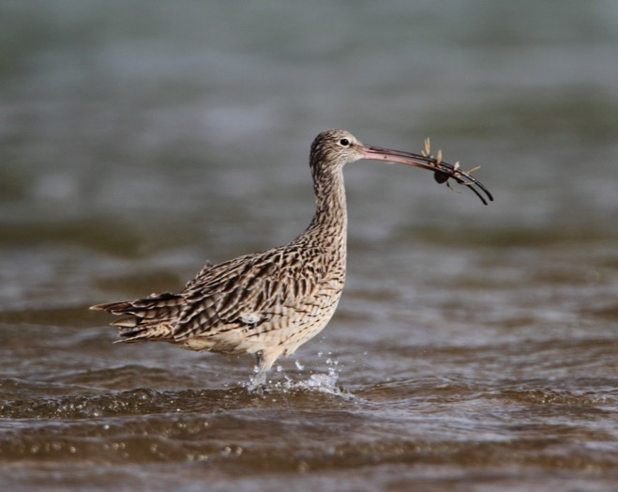
2b. Quantitative observational studies
Statistical models can be fitted to observational data to provide strong inferences!!!
Studds et al. 2017 Nature Comms

Slide 15
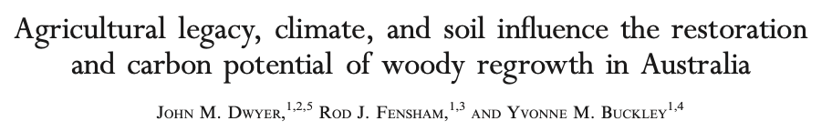
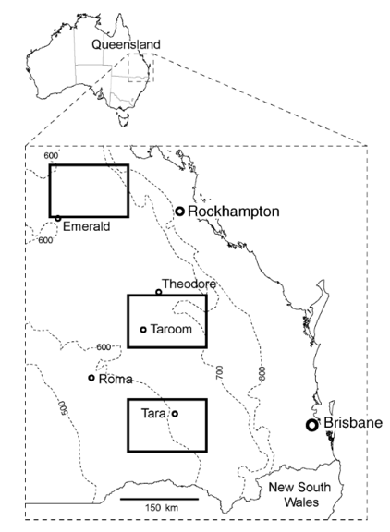
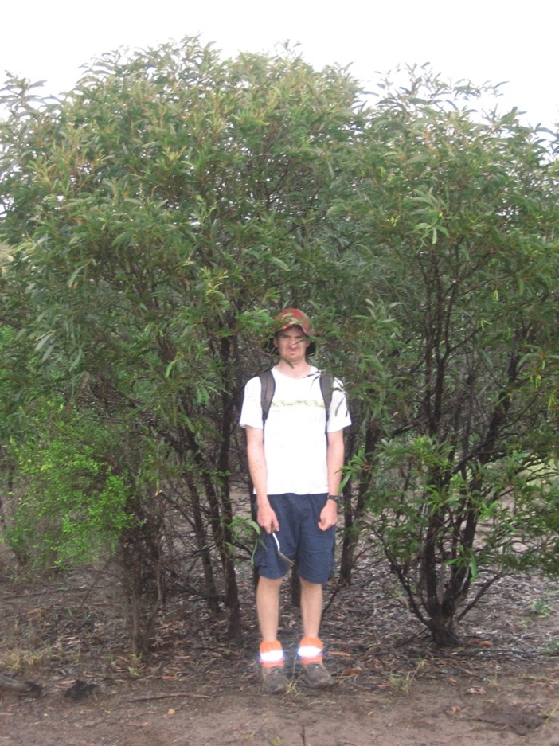
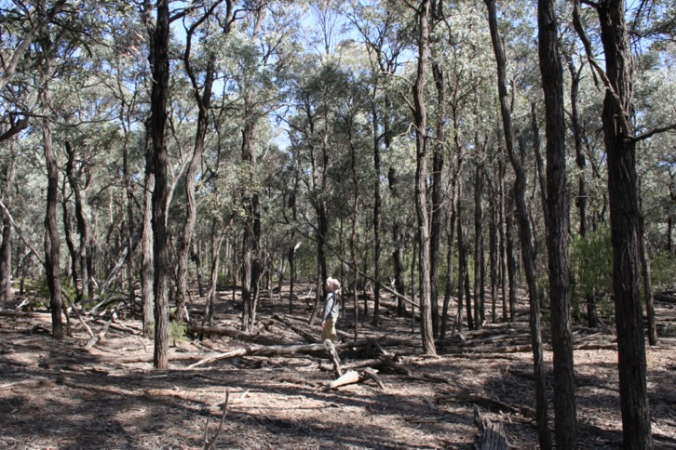

Slide 16
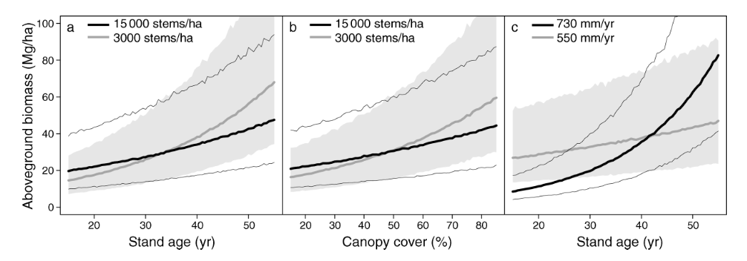

Slide 17
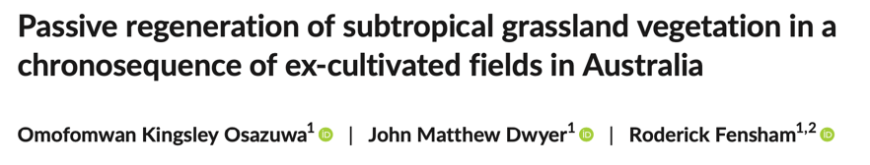
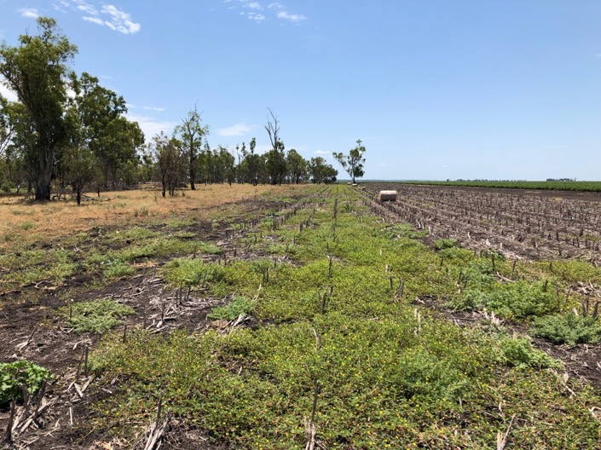
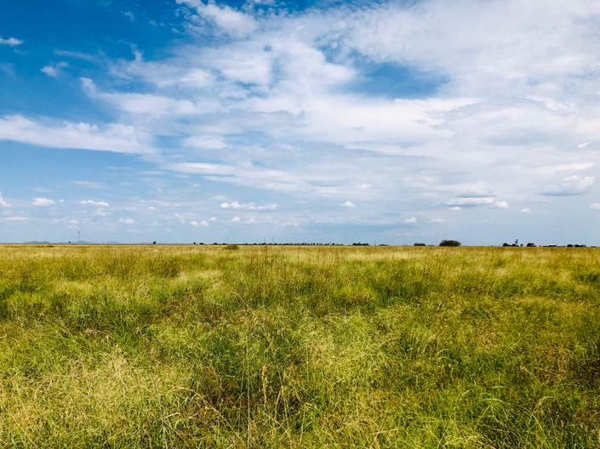

Slide 18
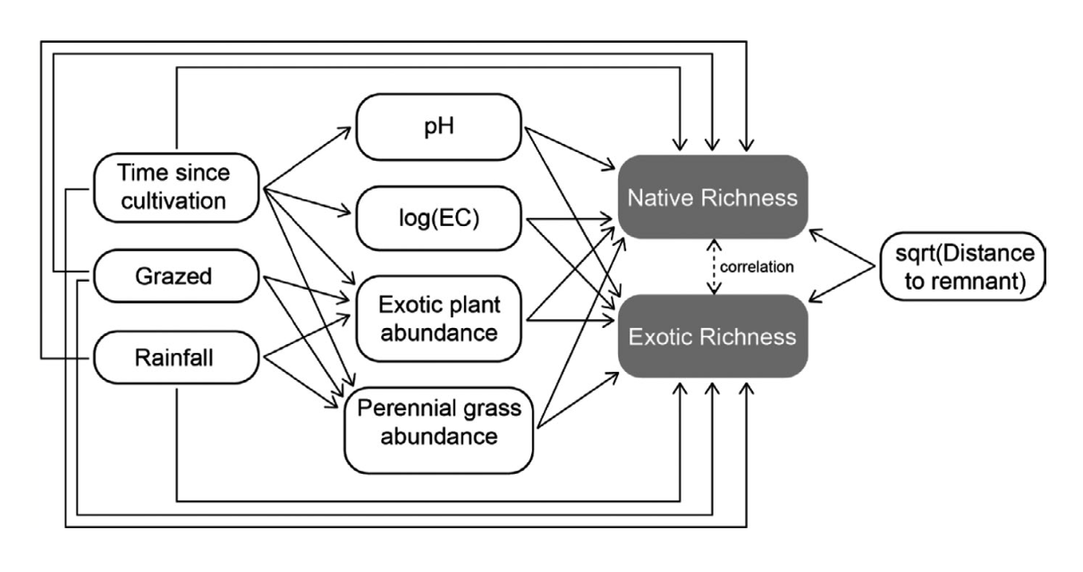

Slide 19
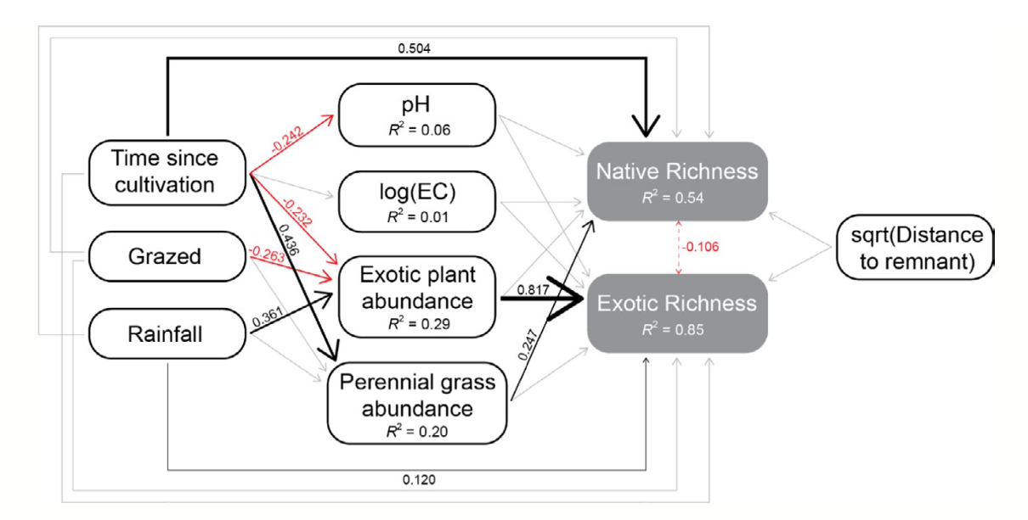

Slide 20
2b. Quantitative observational studies
Ask yourself:
Was there an experimental manipulation of something?
If no, its probably an observational study
Even is we take advantage of previous ad hoc manipulations (e.g. clearing of brigalow at different times in the past), it’s still observational

Slide 21
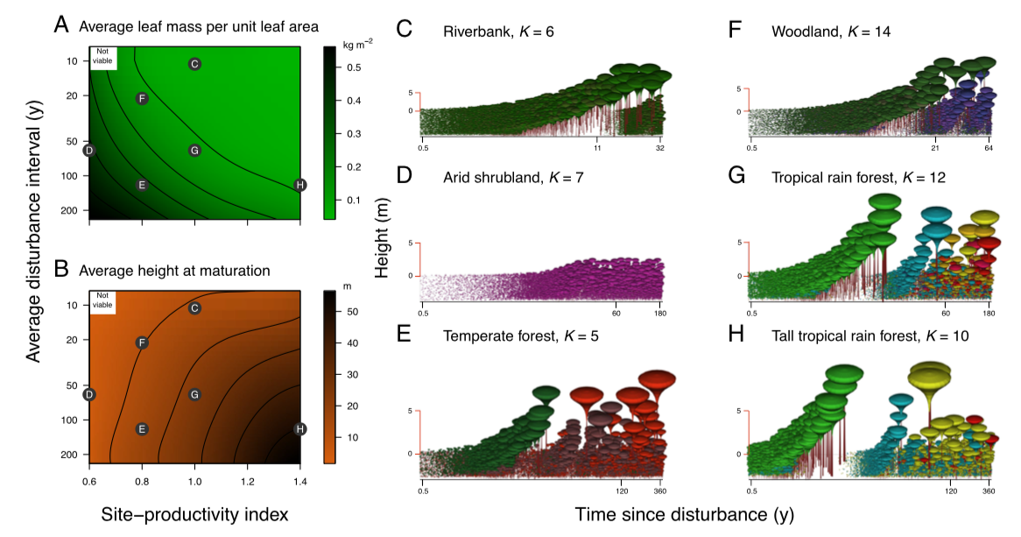
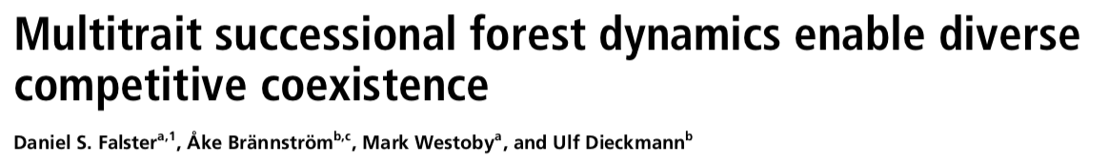
3. Mathematical models
Understand how systems work

Slide 22
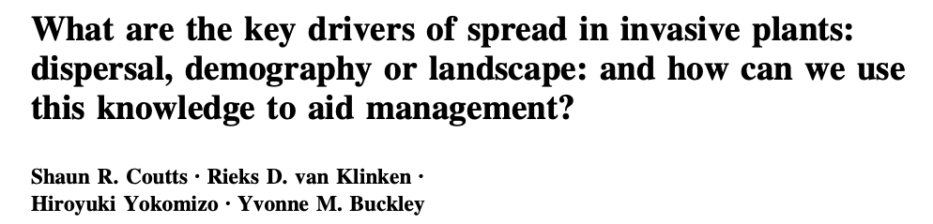
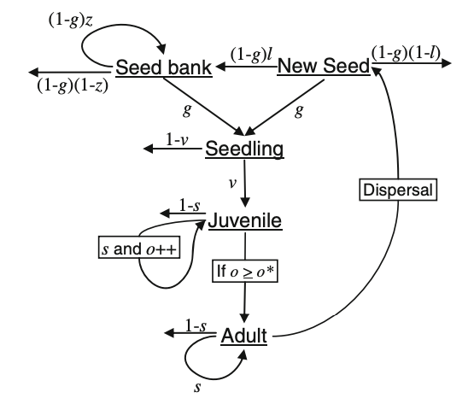

Slide 23
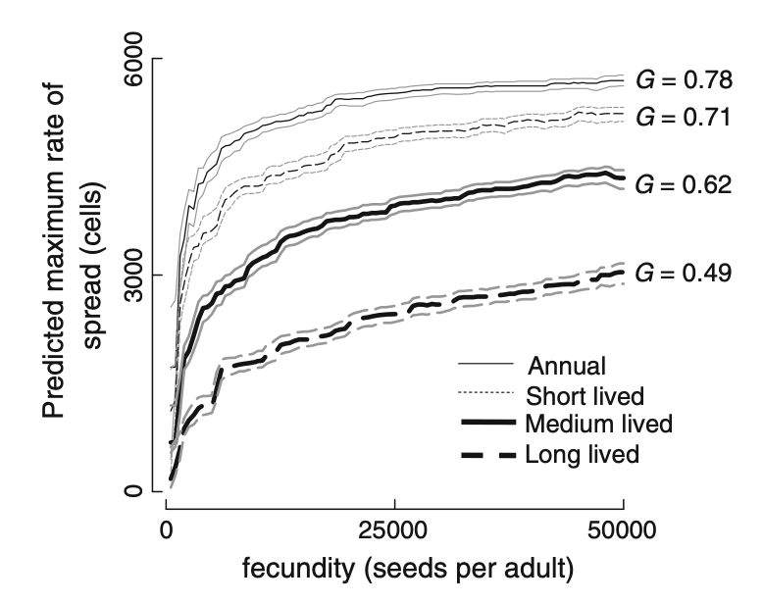

Slide 24
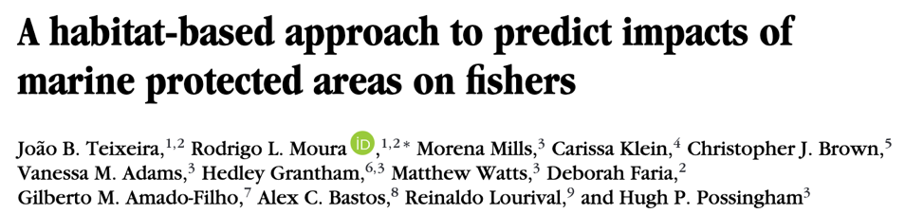
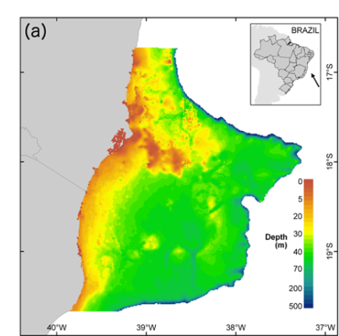
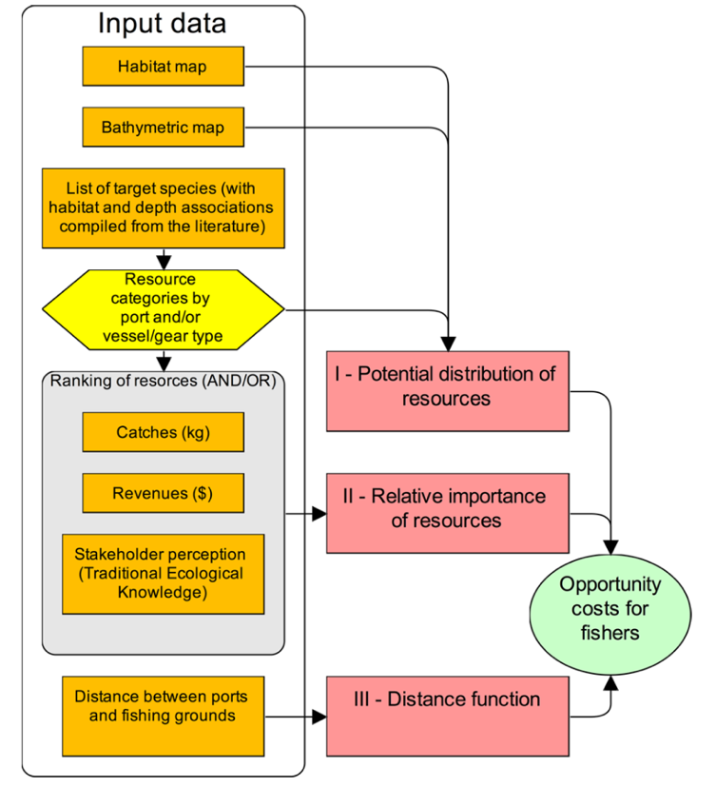

Slide 25
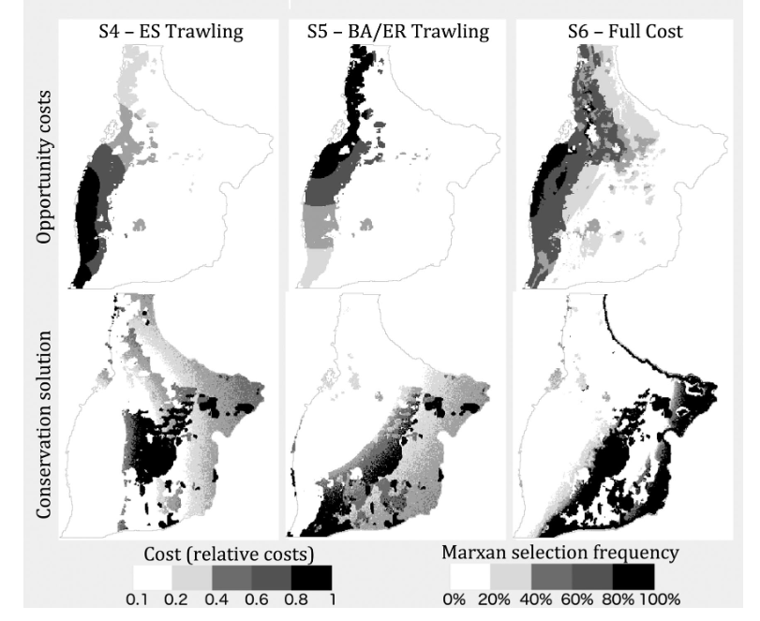

Slide 26
4. Experiments
Manipulate the system and measure a response!
Make sure you measure controls that you didn’t manipulate!!!
Best method to determine CAUSATION

Slide 27
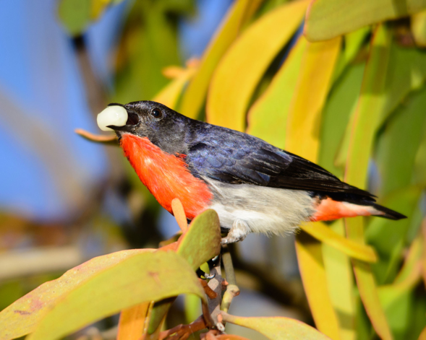
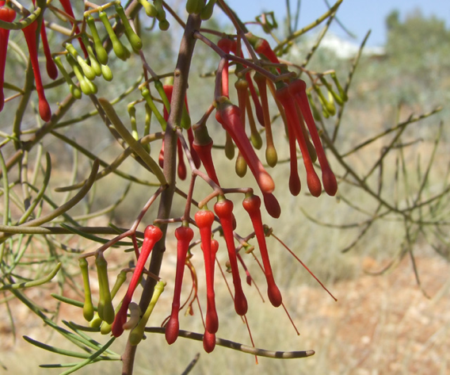
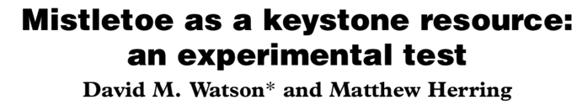
Experiments
Prediction: Mistletoes are an important foraging resource for many woodland-dependent birds

Slide 28
Experiments
Hypothesis: Removal of mistletoe from Eucalypt woodlands reduces the diversity of bird species within a few years

Slide 29
Experiments
Design: Remove mistletoes from entire plots and leave others intact as controls
Monitor bird composition & abundance for multiple years

Slide 30
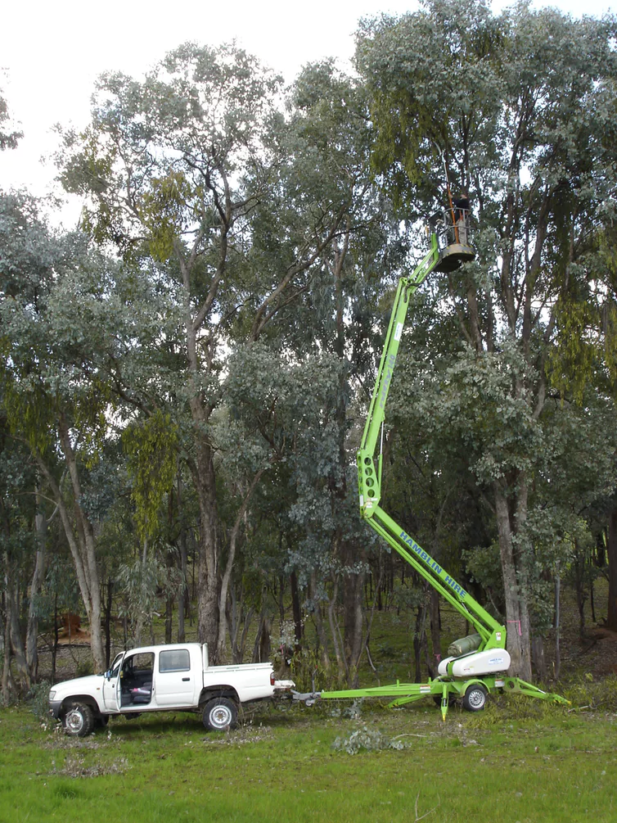

Slide 31
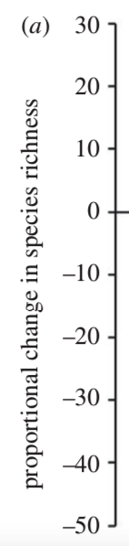
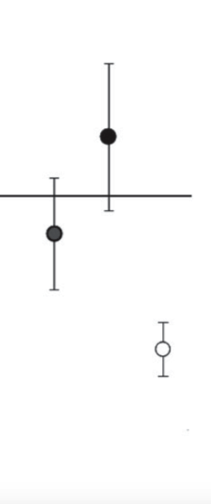
Experiments
Conclusion: The hypothesis is supported!
Two types of control plots!
Plots with mistletoes removed!

Slide 32
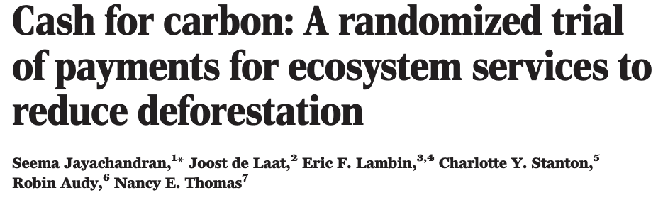
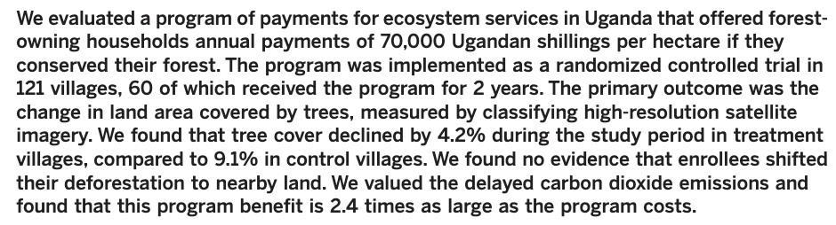
See this nice Conversation article:
https://theconversation.com/more-experiments-may-help-explore-what-works-in-conservation-106190

Slide 33
Coming up
Thursday 1pm Workshop: Understanding distributions
Thursday 5pm Lecture (Rich Fuller): Case study: Migratory shorebirds
Pre-recorded stats lecture: Sampling from populations and the normal distribution
Friday R Prac: Estimation and descriptive statistics

